Slide 1




Wissenswertes über die
HPV-Impfung
Elmar A. Joura
Universitätsklinik für Frauenheilkunde, AKH Wien
Wien, 2 Juni 2014

Slide 2
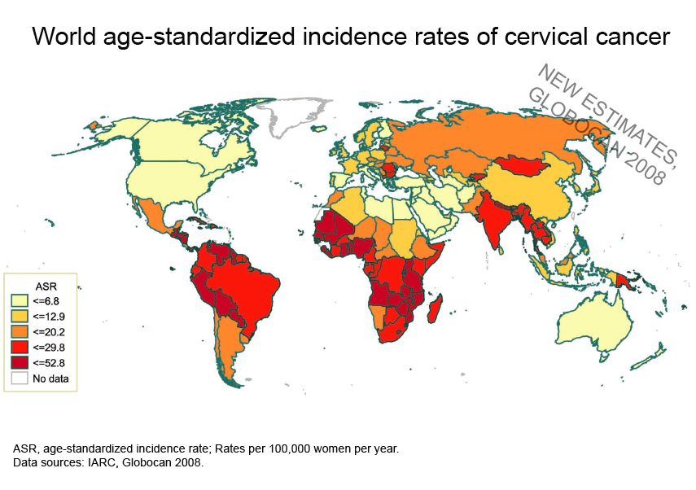

Slide 3

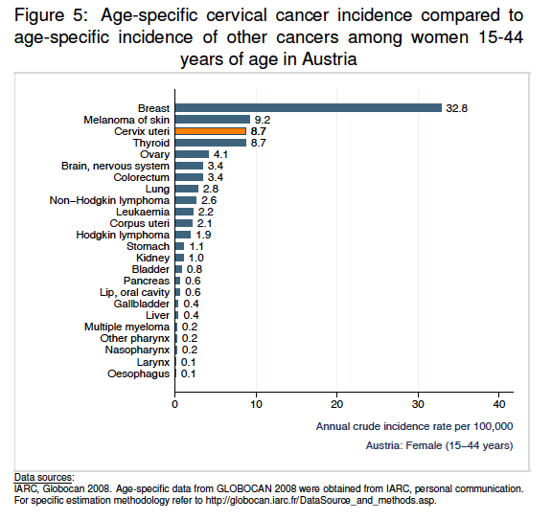
Cervical Cancer Austria <45a

Slide 4


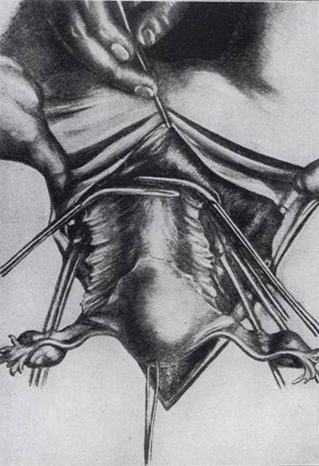
1897 Ernst Wertheim

Slide 5
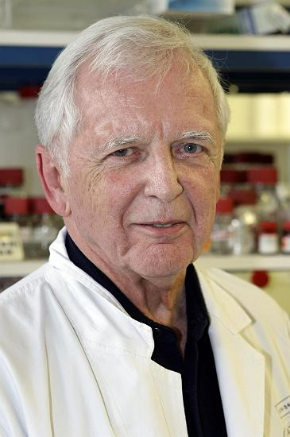
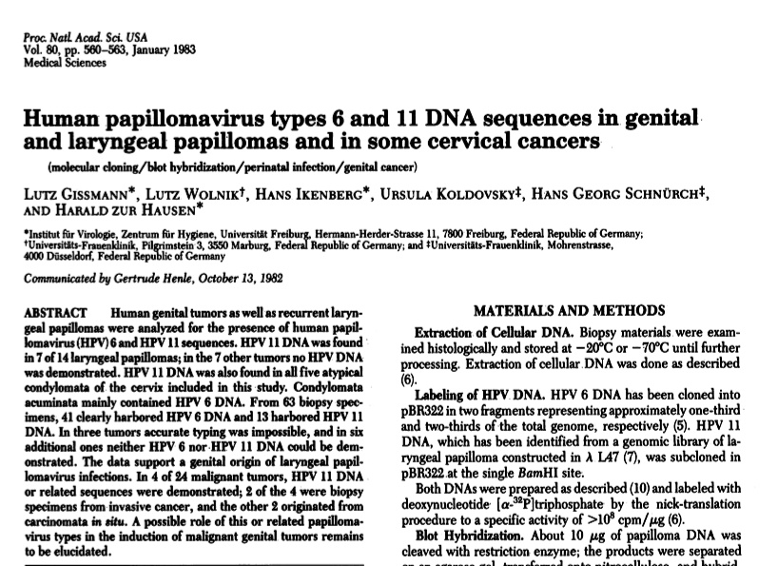
Nobelpreis für Medizin und Biologie 2008
Harald zur Hausen

Slide 6
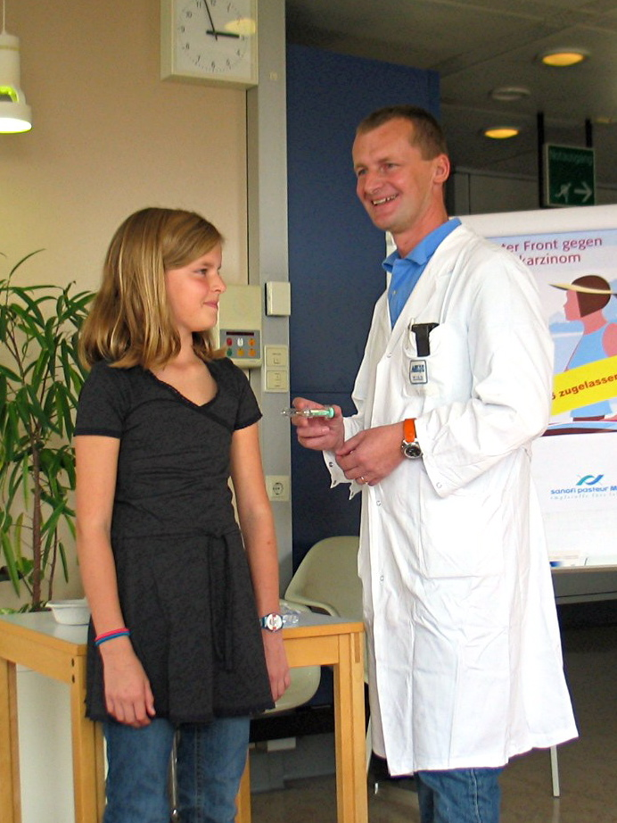
FUTURE I Studie (Phase III)
quadrivalente HPV- Impfstoff
  größtes europäisches Studienzentrum
  erste Probandin außerhalb der USA 6/2002
22.September 2006 Zulassung durch die EMEA
30. September 2006
  1. HPV Impfung in Europa

Slide 7
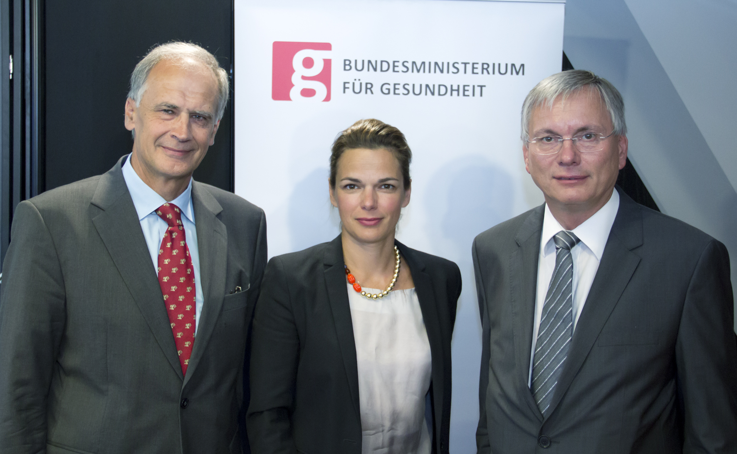
12.8.2013
Die HPV- Impfung wird ab Februar 2014 für alle in Österreich lebenden Kinder in der vierten Schulstufe (vollendetes neuntes Lebensjahr) kostenfrei im Rahmen des bestehenden Schulimpfprogramms angeboten

Slide 8
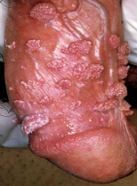

HPV- Impfung für Buben?
Condylome
♂ > ♀
  Risikofaktor für die Partnerin (RR 10!)
  Herdenimmunität

Slide 9
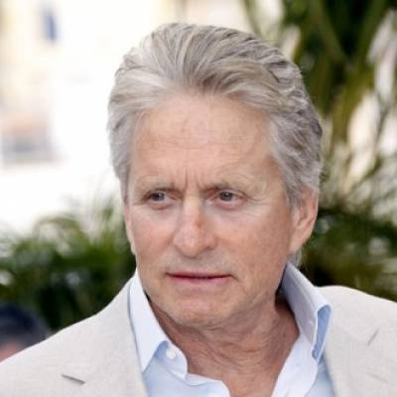
HPV- assoziierte Karzinome
Männer USA 2004-8
9400 Karzinome Oropharynx
1700 Analkarzinome
  2/100.000
  35/100.000 MSM (HIV-)
1000 Peniskarzinome
  Frauen
    12000 Zervixkarzinome
    3900 Vulva/Vaginalkarzinome
    3100 Analkarzinome
    2400 Oropharynx
MMWR April 2012

Slide 10

HPV - Related Cancers in Men and Women
Penile Cancer
1000
3,700
Vulvar & Vaginal Cancer
Anal Cancer
1,600
2,800
Anal Cancer
H&N Cancer
11,600
2,300
H&N Cancer
23,000
Cervical Cancer
MALE
FEMALE
329,000
292,000
Genital warts
Genital warts
Annual new cancers and genital warts cases related to HPV 6,11,16 and/or 18 in Males and Females in Europe
Annual number of new cancer cases calculated based on crude incidence rates from IARC database (1998-2002) and population estimate Eurostat 2008; estimate Globocan 2008 for cervical cancer; published HPV prevalence rates were applied (for Europe, when available) Genital warts estimates based on incidence rates in UK, HPA 2007

Slide 11
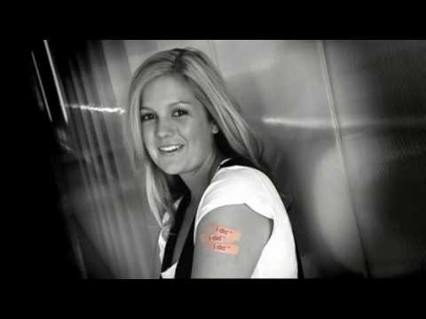
Libby Trickett – „I did it“
Olympic Gold Medalist - Athens 2004 - Beijing 2008 - London 2012 - WR 100m freestyle

Slide 12
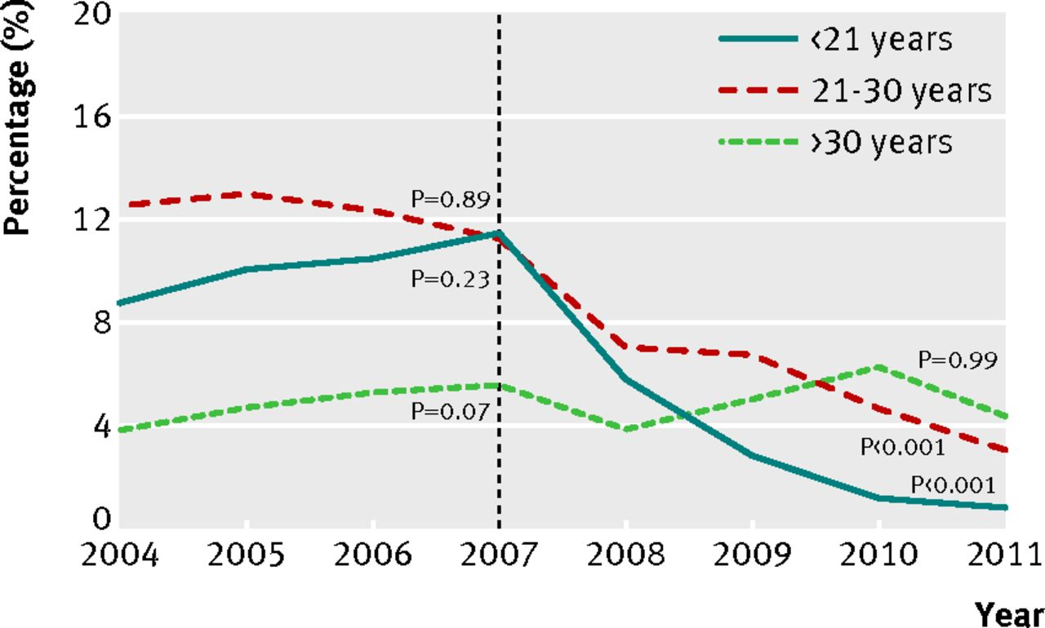

Fig 1 Proportion of Australian born women diagnosed as having genital warts at first visit, by age group, 2004-11.
Ali H et al. BMJ 2013;346:bmj.f2032
©2013 by British Medical Journal Publishing Group
Notes:
Fig 1 Proportion of Australian born women diagnosed as having genital warts at first visit, by age group, 2004-11

Slide 13
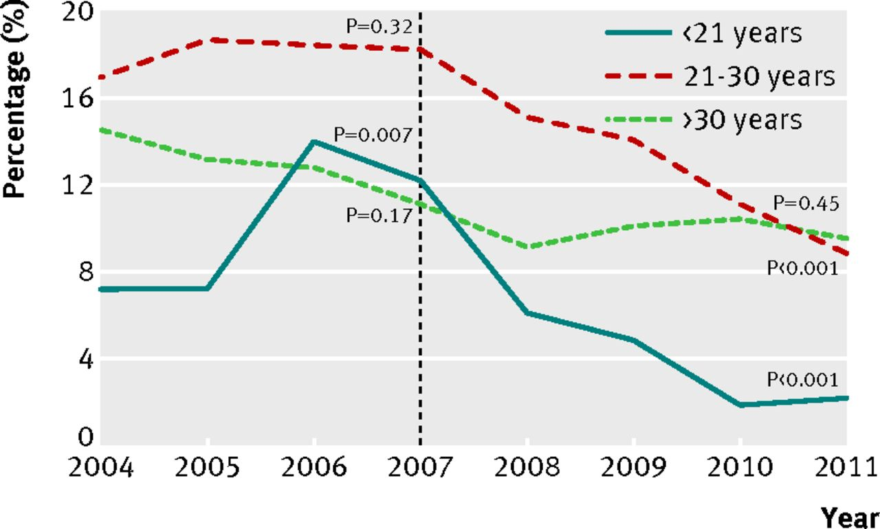
Fig 3 Proportion of Australian born heterosexual men diagnosed as having genital warts at first visit, by age group, 2004-11.
Ali H et al. BMJ 2013;346:bmj.f2032
©2013 by British Medical Journal Publishing Group
Notes:
Fig 3 Proportion of Australian born heterosexual men diagnosed as having genital warts at first visit, by age group, 2004-11

Slide 14

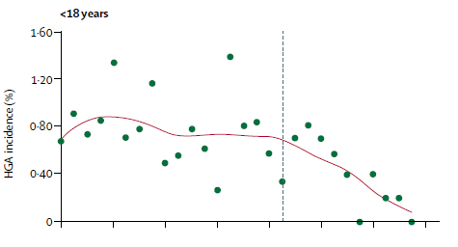
Impact in Australia
Cervical high-grade abnormalities (HGA)
- 47.5%
p=0.003
2004
2010
Start of vaccination programme (mid-2007)
A relative reduction of ~50% was observed in this age group, post vaccination vs. pre vaccination, barely 3 years after the introduction and the trend continues¹
Similar early trends have been observed in the US on abnormal Pap smears²
1. Brotherton J et al. Lancet 2011
2. Gross et al. J Pediatr Adolesc Gynecol 2010
Notes:
There is some recently published additional evidence from Australia to support the clinical benefits of Gardasil® in preventing high grade precursor lesions, which would have an important impact on associated cost-offsets and QALYs gained, potentially altering the cost-effectiveness and economic profile for Gardasil®.
CSS statement they achieved this due to vaccinating up to 26
Cervical cancer screening in Australia is accessible to young women immediately after sexual debut and as shown here, Brotherton and colleagues have reported a decrease in incidence of high grade cervical abnormalities in women under the age of 18 years in Victoria, Australia, within 3 years of the implementation of the national quadrivalent HPV vaccination programme.[2] amounting to a relative reduction of ~50% post vaccination vs pre vaccination. (0.42%/ 0.80%= 0.525 → relative risk reduction of 47.5%).
Vaccination uptake in their school based programme was between 71-79%, which is very similar to coverage rates observed in the UK.[3]
Therefore, a similar rapid impact could be expected in the UK population, following the implementation of a Gardasil® vaccination programme in 12-13 year old girls.
As well as improving outcomes for patients in a real-life setting, there is the potential for Gardasil® to have a significant impact on healthcare resource utilisation and QALYs gained, by preventing high grade precursor lesions.
These preliminary data provide further evidence of the early benefits on cervical HGA with quadrivalent vaccination

Slide 15

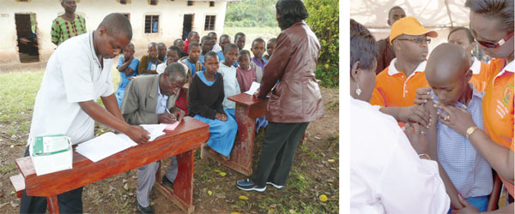
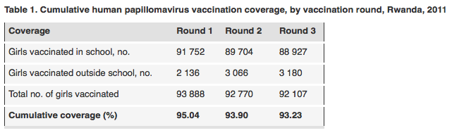
Rwanda
Bulletin of the World Health Organization

Slide 16
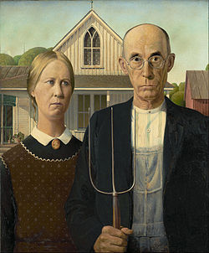
Sexuelle Übertragung
State Sen. George Runner of California :
„American money would be much better spent on other types of vaccines, since cervical cancer is a result of lifestyle choices“

Slide 17

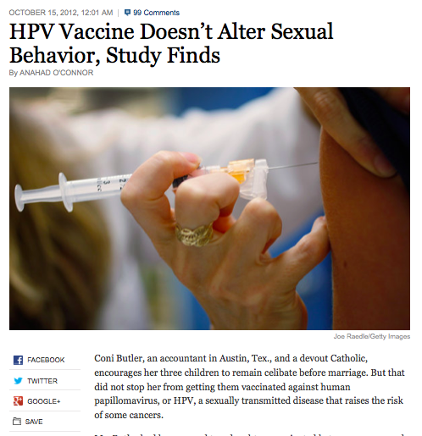

Slide 18
Statistik Austria 2009
HPV 16/18
 | Inzidenz | HPV 16/18*
CX | 394 | 295
Vulva | 128 | 38
Vagina | 26 | 10
Anus | 80 | 66
Kopf/Hals | 273 | 68
Frauen gesamt | 901 | 477
Penis | 58 | 17
Anus | 49 | 40
Kopf/Hals | 851 | 212
Männer gesamt | 958 | 269
Gesamt | 1859 | 746
* Estimation

Slide 19
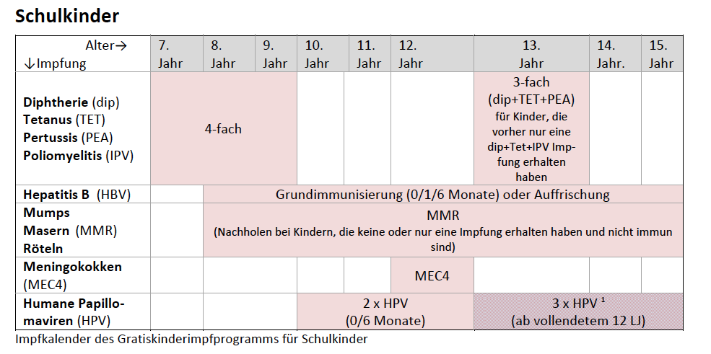
Impfplan 2014 - www.bmg.gv.at

Slide 20
Impfprogramm
Die 1. Teilimpfung im Herbst 2014 in Schulen (4. Schulstufe)
  Die 2.Teilimpfung 2015, 6 Monate nach der Erstimpfung im gleichen Schuljahr
ab 2/ 2014 an den öffentlichen Impfstellen der Bundesländer
  kostenlos ab dem vollendeten 9. Lebensjahr bis zum vollendeten 12.
Catch-up Impfungen zum vergünstigten Selbstkostenpreis
  Kinder bis zum vollendeten Lebensjahr 15. Lebensjahr.
öffentlichen Impfungen in einigen Bundesländern im Auftrag der Länder im privaten Bereich

Slide 21
Immunogenität
Block SL, et al. Pediatrics 2006
1600
Immunogenicity Bridge
Efficacy Program
1500
1300
1100
Serum cLIA GMT with 95% CI, mMUL
900
700
500
9
10
11
12
13
14
15
16
17
18
19
20
21
22
23
Age at enrolment (yrs)

Slide 22
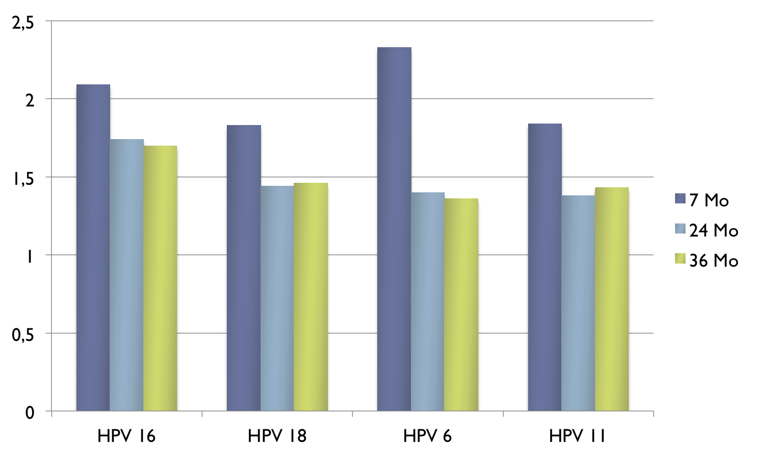
qHPV GMT ratio
9-13 yo 2 dose vs 16-26 yo 3 dose
Dobson et al. JAMA 2013

Slide 23
Global Advisory Committee on
Vaccine Safety (GAVCS)¹
2007: Reviewed newly licensed qHPV vaccine safety: No safety profile concerns
2008: Reviewed data related to large-scale use of qHPV vaccine and data on postlicensure surveillance.
2009: Reviewed postmarketing surveillance studies and 3 reports from independent investigators.
2013: With more than 175 million doses distributed worldwide, it continues to be reassured by the safety profile of the available HPV vaccines
2014: GACVS has not found any safety issue that would alter any of the current recommendations for the use of the vaccine.
No increase in risk of autoimmune diseases including MS.
ªStudies focused on syncope, hypersensitivity, anaphylaxis, and central demyelinating diseases.
qHPV=quadrivalent human papillomavirus; WHO=World Health Organization.
1. World Health Organization (WHO). Wkly Epidemiol Rec. 2009;84:37–40. Weekly epidemiological record Relevé épidémiologique hebdomadaire 14 FEBRUARY 2014, 89th YEAR / 14 FÉVRIER 2014, 89e ANNÉE
Notes:
23
WHO 2009:
p37A
1. World Health Organization (WHO). Wkly Epidemiol Rec. 2009;84:37–40.
WHO 2009:
p39A,B
WHO 2009:
p39A
WHO 2009:
p39A, B
WHO 2009:
p39A

Slide 24
Conclusio
HPV löst viele Erkrankungen aus!
HPV Impfprogramme sind wirksam
  Durchimpfungsrate
  Je jünger desto effektiver
Rascher Rückgang von Erkrankungen
Österreich
  Geschlechtsneutrale Impfung ✔
  Impfalter von 9-10 ideal ✔
  2-Dosen nur im Kinderimpfprogramm!
Eltern und Schulärzte sind der Schlüssel zum Erfolg!

